Slide 1
Chapter 11: Network Address Translation for IPv4
Routing & Switching
Notes:
Cisco Networking Academy program
Routing & Switching
Chapter 11: Network Address Translation for IPv4

Slide 2
Chapter 11
11.1 NAT Operation
11.2 Configuring NAT
11.3 Troubleshooting NAT
11.4 Summary
Notes:
Chapter 11

Slide 3
Chapter 11: Objectives
Describe NAT characteristics.
Describe the benefits and drawbacks of NAT.
Configure static NAT using the CLI.
Configure dynamic NAT using the CLI.
Configure PAT using the CLI.
Configure port forwarding using the CLI.
Configure NAT64.
Use show commands to verify NAT operation.
Notes:
Chapter 11 Objectives

Slide 4
11.1 NAT Operation
Notes:
11.1 NAT Operation

Slide 5
NAT Characteristics IPv4 Private Address Space
IPv4 address space is not big enough to uniquely address all the devices that must be connected to the Internet.
Network private addresses are described in RFC 1918 and are to designed to be used within an organization or site only.
Private addresses are not routed by Internet routers while public addresses are.
Private addresses can alleviate IPv4 scarcity, but because they aren’t routed by Internet devices, they first need to be translated.
NAT is process used to perform such translation.
Notes:
11.1.1.1 IPv4 Private Address Space

Slide 6
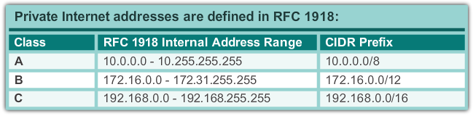
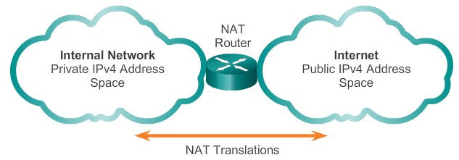
NAT Characteristics IPv4 Private Address Space
Notes:
11.1.1.1 IPv4 Private Address Space

Slide 7
NAT Characteristics What is NAT?
NAT is a process used to translate network addresses.
NAT’s primary use is to conserve public IPv4 addresses.
NAT is usually implemented at border network devices, such as firewalls or routers.
NAT allows the networks to use private addresses internally, only translating to public addresses when needed.
Devices within the organization can be assigned private addresses and operate with locally unique addresses.
When traffic must be sent or received to or from other organizations or the Internet, the border router translates the addresses to a public and globally unique address.
Notes:
11.1.1.2 What is NAT?

Slide 8
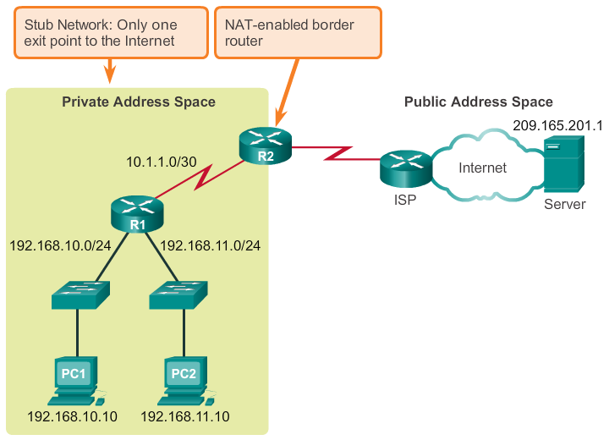
NAT Characteristics What is NAT? (cont.)
Notes:
11.1.1.2 What is NAT? (cont.)

Slide 9
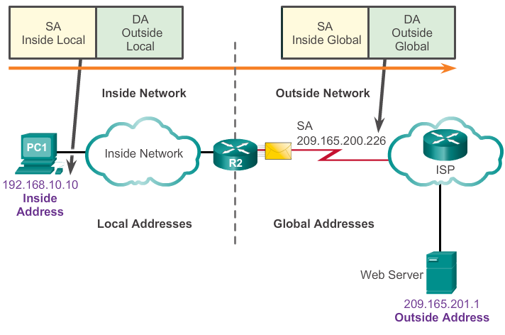
NAT Characteristics NAT Terminology
Inside network is the set of devices using private addresses
Outside network refers to all other networks
NAT includes four types of addresses:
Inside local address
Inside global address
Outside local address
Outside global address
Notes:
11.1.1.3 NAT Terminology

Slide 10
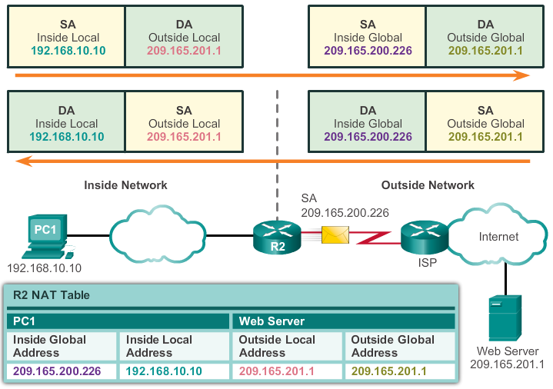
NAT Characteristics NAT Terminology (cont.)
Notes:
11.1.1.4 NAT Terminology (cont.)

Slide 11
Types of NAT Static NAT
Static NAT uses a one-to-one mapping of local and global addresses.
These mappings are configured by the network administrator and remain constant.
Static NAT is particularly useful when servers hosted in the inside network must be accessible from the outside network.
A network administrator can SSH to a server in the inside network by pointing the SSH client to the proper inside global address.
Notes:
11.1.2.1 Static NAT

Slide 12
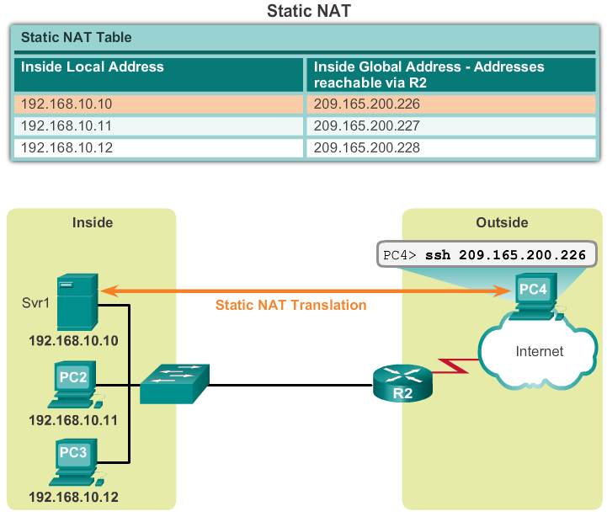
Types of NAT Static NAT (cont.)
Notes:
11.1.2.1 Static NAT (cont.)

Slide 13
Types of NAT Dynamic NAT
Dynamic NAT uses a pool of public addresses and assigns them on a first-come, first-served basis.
When an inside device requests access to an outside network, dynamic NAT assigns an available public IPv4 address from the pool.
Dynamic NAT requires that enough public addresses are available to satisfy the total number of simultaneous user sessions.
Notes:
11.1.2.2 Dynamic NAT

Slide 14
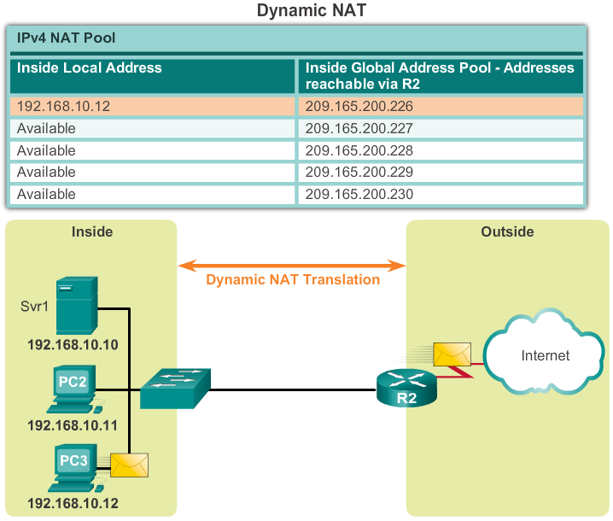
Types of NAT Dynamic NAT (cont.)
Notes:
11.1.2.2 Dynamic NAT (cont.)

Slide 15
Types of NAT Port Address Translation
Port Address Translation (PAT) maps multiple private IPv4 addresses to a single public IPv4 address or a few addresses.
PAT uses the pair source port and source IP address to keep track of what traffic belongs to what internal client.
PAT is also known as NAT overload.
By also using the port number, PAT forwards the response packets to the correct internal device.
The PAT process also validates that the incoming packets were requested, thus adding a degree of security to the session.
Notes:
11.1.2.3 Port Address Translation NAT

Slide 16
Types of NAT Comparing NAT and PAT
NAT translates IPv4 addresses on a 1:1 basis between private IPv4 addresses and public IPv4 addresses.
PAT modifies both the address and the port number.
NAT forwards incoming packets to their inside destination by referring to the incoming source IPv4 address provided by the host on the public network.
With PAT, there is generally only one or a very few publicly exposed IPv4 addresses.
PAT is able to translate protocols that do not use port numbers, such as ICMP; each one of these protocols is supported differently by PAT.
Notes:
11.1.2.5 Comparing NAT and PAT

Slide 17
Benefits of NAT Benefits of NAT
Conserves the legally registered addressing scheme
Increases the flexibility of connections to the public network
Provides consistency for internal network addressing schemes
Provides network security
Notes:
11.1.3.1 Benefits of NAT

Slide 18
Benefits of NAT Disadvantages of NAT
Performance is degraded
End-to-end functionality is degraded
End-to-end IP traceability is lost
Tunneling is more complicated
Initiating TCP connections can be disrupted
Notes:
11.1.3.2 Disadvantages of NAT

Slide 19
11.2 Configuring NAT
Notes:
11.2 Configuring NAT

Slide 20
Configuring Static NAT Configuring Static NAT
There are two basic tasks to perform when configuring static NAT translations:
Create the mapping between the inside local and outside local addresses.
Define which interfaces belong to the inside network and which belong to the outside network.
Notes:
11.2.1.1 Configuring Static NAT

Slide 21
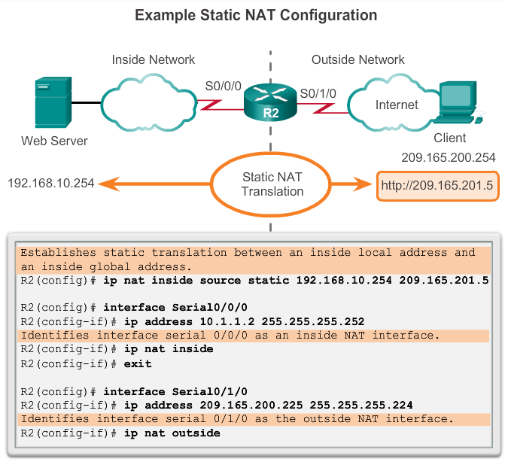
Configuring Static NAT Configuring Static NAT
Notes:
11.2.1.1 Configuring Static NAT

Slide 22
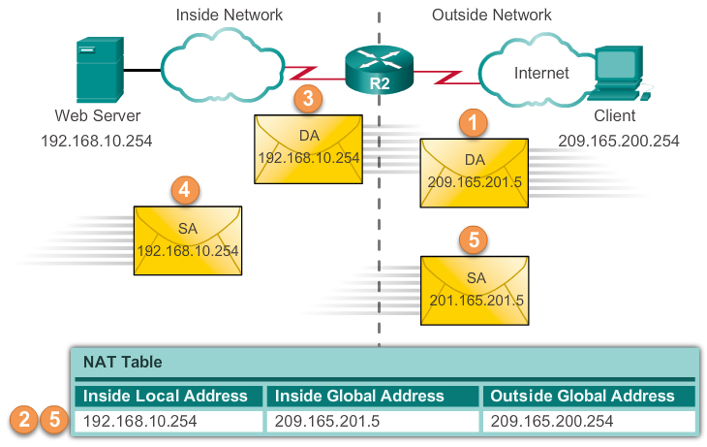
Configuring Static NAT Analyzing Static NAT
Notes:
11.2.1.2 Analyzing Static NAT

Slide 23
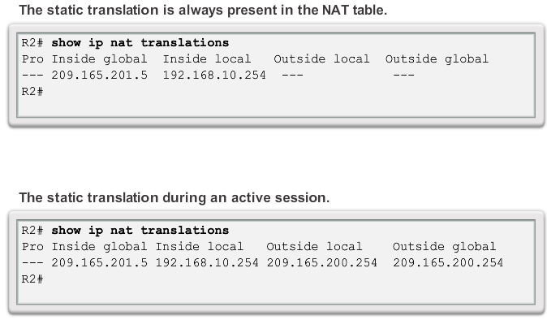
Configuring Static NAT Verifying Static NAT
Notes:
11.2.1.2 Verifying Static NAT

Slide 24
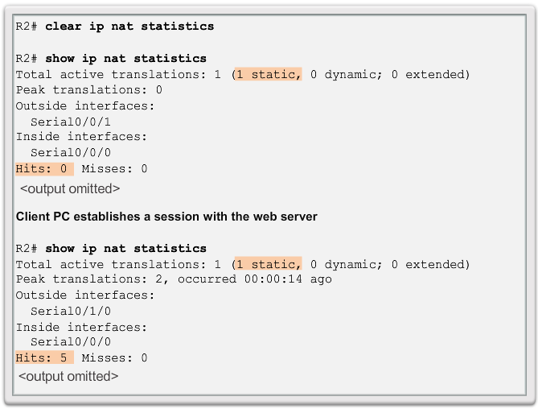
Configuring Static NAT Verifying Static NAT (cont.)
Notes:
11.2.1.2 Verifying Static NAT

Slide 25
Configuring Dynamic NAT Dynamic NAT Operation
The pool of public IPv4 addresses (inside global address pool) is available to any device on the inside network on a first-come, first-served basis.
With dynamic NAT, a single inside address is translated to a single outside address.
The pool must be large enough to accommodate all inside devices.
A device is unable to communicate to any external networks if no addresses are available in the pool.
Notes:
11.2.2.1 Dynamic NAT Operation

Slide 26
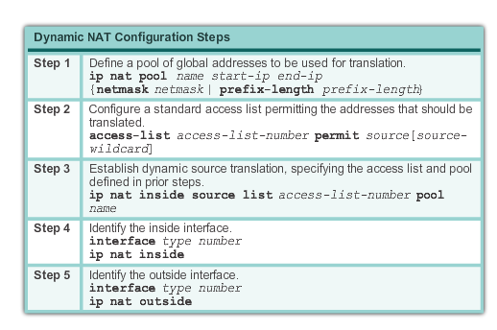
Configuring Dynamic NAT Configuring Dynamic NAT
Notes:
11.2.2.2 Configuring Dynamic NAT

Slide 27
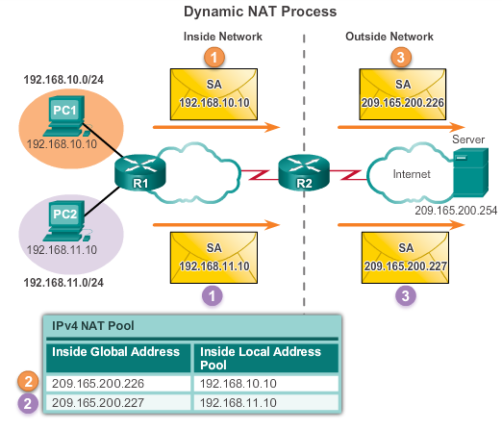
Configuring Dynamic NAT Analyzing Dynamic NAT
Notes:
11.2.2.3 Analyzing Dynamic NAT

Slide 28
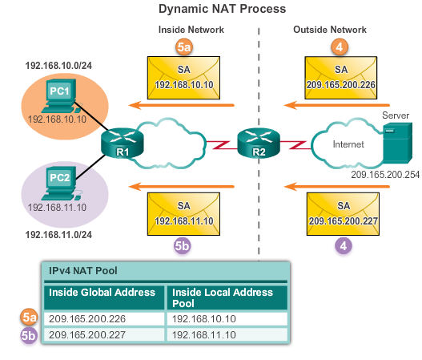
Configuring Dynamic NAT Analyzing Dynamic NAT
Notes:
11.2.2.3 Analyzing Dynamic NAT

Slide 29
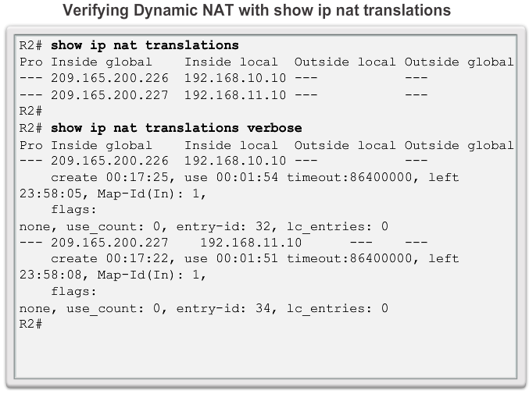
Configuring Dynamic NAT Verifying Dynamic NAT
Notes:
11.2.2.4 Verifying Dynamic NAT

Slide 30
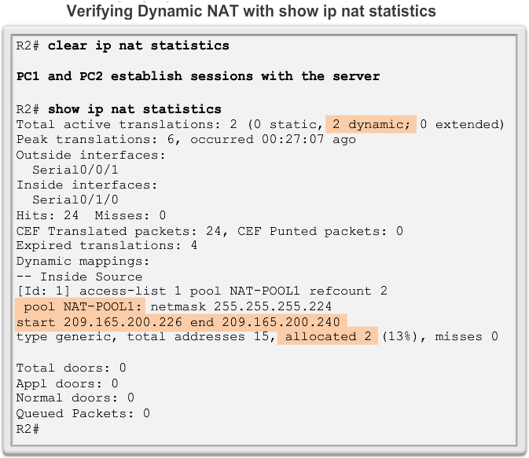
Configuring Dynamic NAT Verifying Dynamic NAT
Notes:
11.2.2.4 Verifying Dynamic NAT

Slide 31
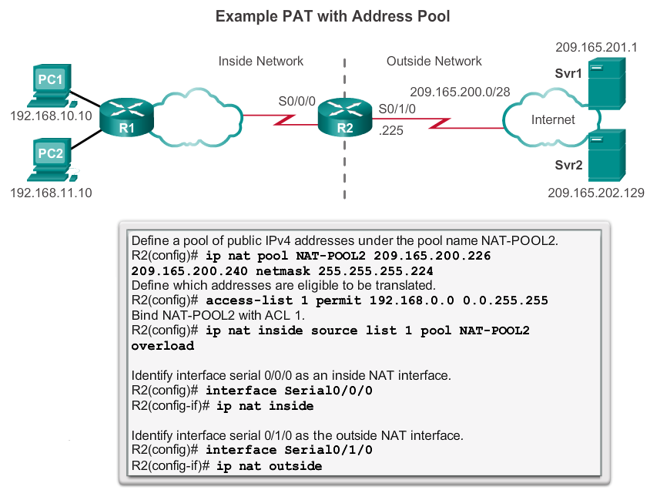
Configuring PAT Configuring PAT: Address Pool
Notes:
11.2.3.1 Configuring PAT: Address Pool

Slide 32
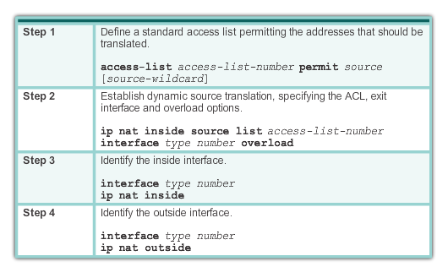
Configuring PAT Configuring PAT: Single Address
Notes:
11.2.3.2 Configuring PAT: Single Address

Slide 33
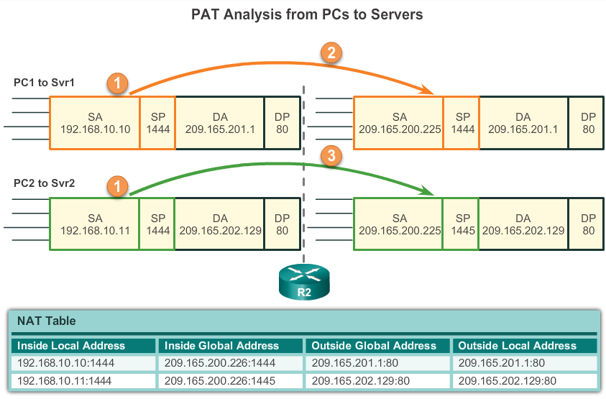
Configuring PAT Analyzing PAT
Notes:
11.2.3.3 Analyzing PAT

Slide 34
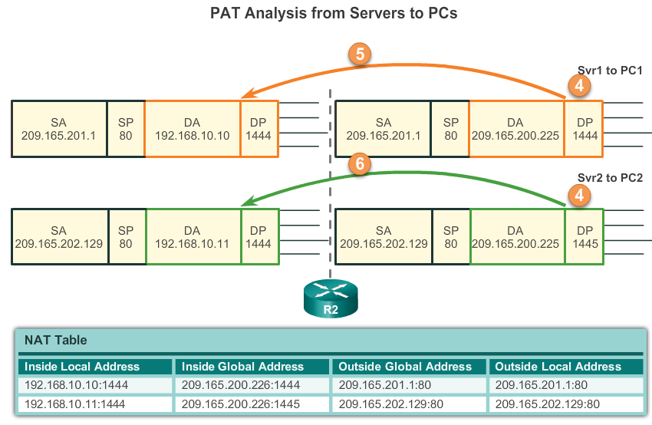
Configuring PAT Analyzing PAT
Notes:
11.2.3.3 Analyzing PAT

Slide 35
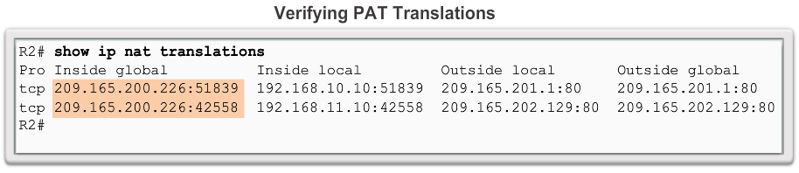
Configuring PAT Verifying PAT Translations
Notes:
11.2.3.4 Verifying PAT

Slide 36
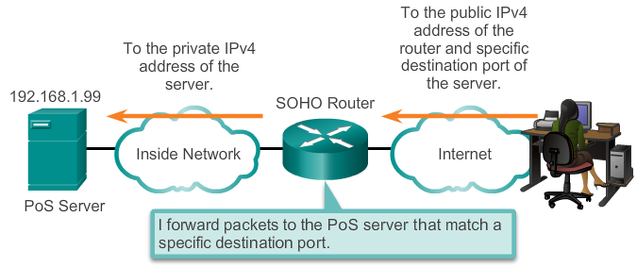
Port Forwarding Port Forwarding
Port forwarding is the act of forwarding a network port from one network node to another.
A packet sent to the public IP address and port of a router can be forwarded to a private IP address and port in inside network.
Port forwarding is helpful in situations where servers have private addresses, not reachable from the outside networks.
Notes:
11.2.4.1 Port Forwarding

Slide 37
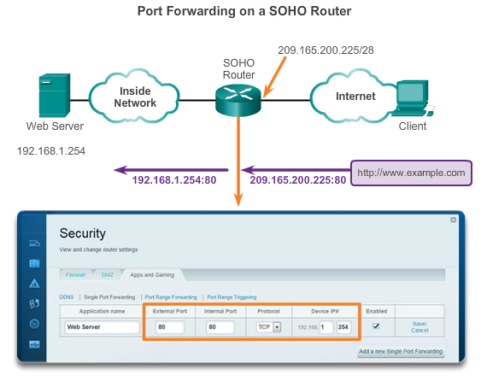
Port Forwarding SOHO Example
Notes:
11.2.4.2 SOHO Example

Slide 38
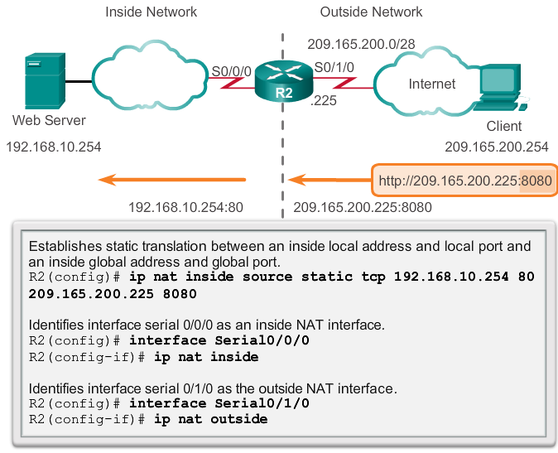
Port Forwarding Configuring Port Forwarding with IOS
In IOS, Port forwarding is essentially a static NAT translation with a specified TCP or UDP port number.
Notes:
11.2.4.3 Configuring Port Forwarding with IOS

Slide 39
Configuring NAT and IPv6 NAT for IPv6?
NAT is a workaround for IPv4 address scarcity.
IPv6 with a 128-bit address provides 340 undecillion addresses.
Address space is not an issue for IPv6.
IPv6 makes IPv4 public-private NAT unnecessary by design; however, IPv6 does implement a form of private addresses, and it is implemented differently than they are for IPv4.
Notes:
11.2.5.1 NAT for IPv6?

Slide 40
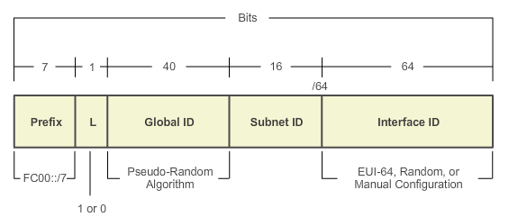
Configuring NAT and IPv6 IPv6 Unique Local Addresses
IPv6 unique local addresses (ULAs) are designed to allow IPv6 communications within a local site.
ULAs are not meant to provide additional IPv6 address space.
ULAs have the prefix FC00::/7, which results in a first hextet range of FC00 to FDFF.
ULAs are also known as local IPv6 addresses (not to be confused with IPv6 link-local addresses).
Notes:
11.2.5.2 IPv6 Unique Local Addresses

Slide 41
Configuring NAT and IPv6 NAT for IPv6
IPv6 also uses NAT, but in a much different context.
In IPv6, NAT is used to provide transparent communication between IPv6 and IPv4.
NAT64 is not intended to be a permanent solution; it is meant to be a transition mechanism.
Network Address Translation-Protocol Translation (NAT-PT) was another NAT-based transition mechanism for IPv6, but is now deprecated by IETF.
NAT64 is now recommended.
Notes:
11.2.5.3 NAT for IPv6

Slide 42
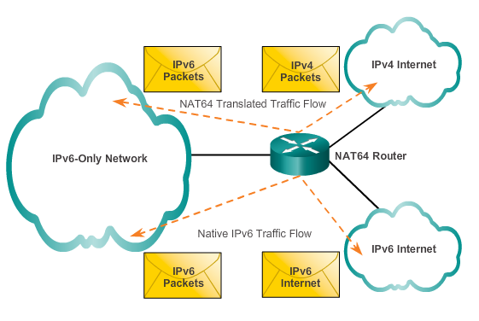
Configuring NAT and IPv6 NAT for IPv6
Notes:
11.2.5.3 NAT for IPv6

Slide 43
11.3 Troubleshooting NAT
Notes:
11.3 Troubleshooting NAT

Slide 44
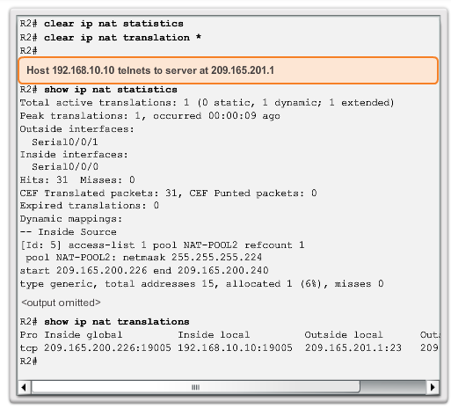
Configuring NAT and IPv6 Troubleshooting NAT: show commands
Notes:
11.3.1.1 Troubleshooting NAT: show commands

Slide 45
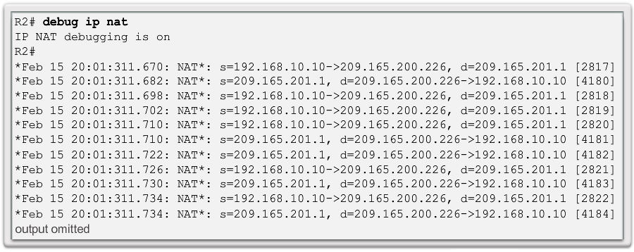
Configuring NAT and IPv6 Troubleshooting NAT: debug command
Notes:
11.3.1.2 Troubleshooting NAT: debug command

Slide 46
Chapter 11: Summary
This chapter has outlined:
How NAT is used to help alleviate the depletion of the IPv4 address space.
NAT conserves public address space and saves considerable administrative overhead in managing adds, moves, and changes.
NAT for IPv4, including:
NAT characteristics, terminology, and general operations
Different types of NAT, including static NAT, dynamic NAT, and NAT with overloading
Benefits and disadvantages of NAT
The configuration, verification, and analysis of static NAT, dynamic NAT, and NAT with overloading.
Notes:
Chapter 11 Summary

Slide 47
Chapter 11: Summary (cont.)
How port forwarding can be used to access an internal devices from the Internet.
Troubleshooting NAT using show and debug commands.
How NAT for IPv6 is used to translate between IPv6 addresses and IPv4 addresses.
Notes:
Chapter 11 Summary

Slide 48


